Slide 1

24CSA212 –
Full Stack Frameworks
Introduction to Web Development -Introduction to Full Stack -Introduction to MERN Stack -Setting up Development Environment - Basics of HTML, CSS, and JavaScript -Introduction to MongoDB

Slide 2
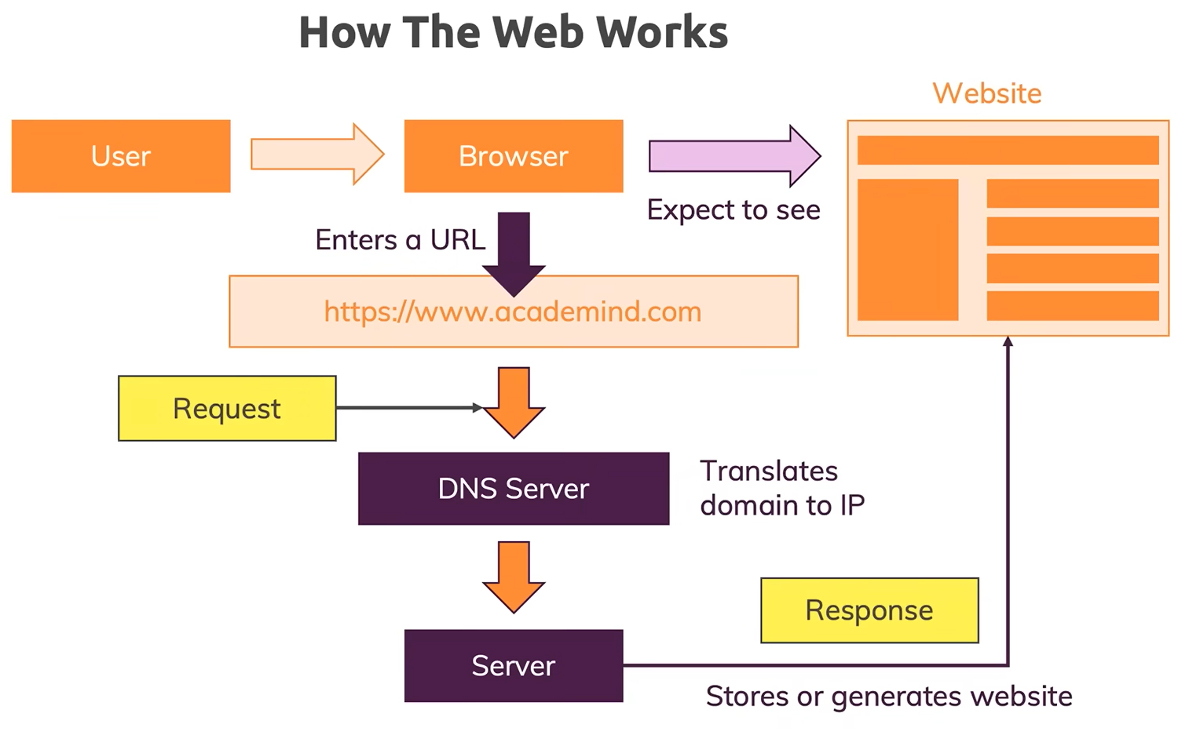
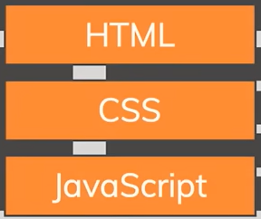

Slide 3


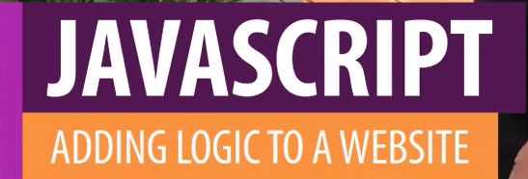

Slide 4
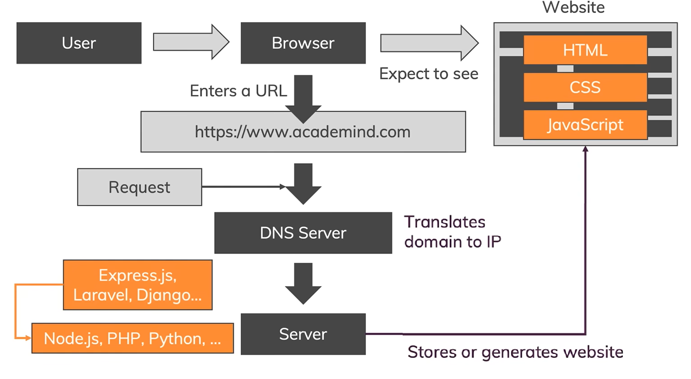

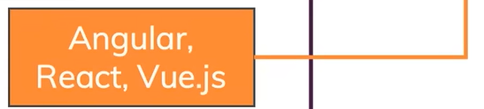
More Technologies involved
Server Side Coding – Node.JS, PHP, Python …
Frameworks – Packages of utility functions that also give info about how to use them
Browser side – Need not load the page each time. Tell What to change, when

Slide 5
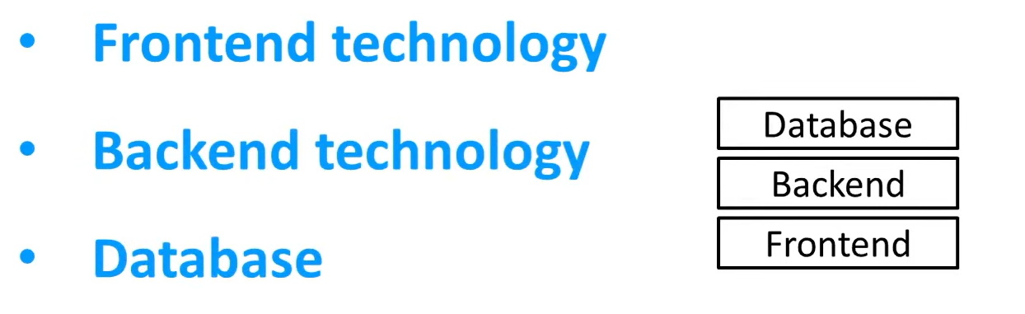
Technology Stack
Technology stack is a collection of three tiers of technologies.
Full stack developer is a person who can work on frontend, back end and Database

Slide 6
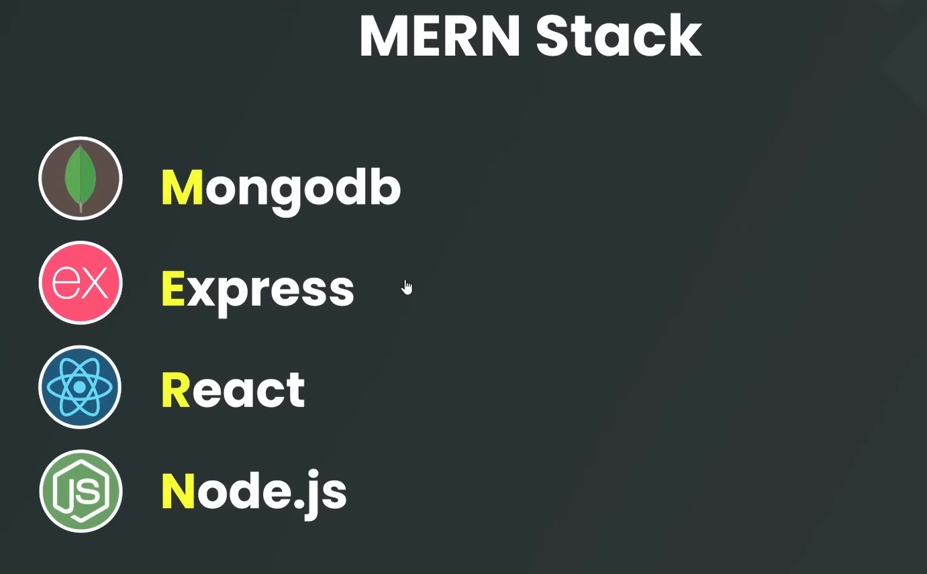
Express JS is a framework which runs inside NodeJS. It handles all the requests and responses coming from the frontend to the backend.
Client Side – Front end library, On the web end where the user is interacting with your website or web application, is called client side
Node JS - Server side – where your logics will run or request or response will be done
It is a runtime environment which is used to build the application on server-end

Slide 7
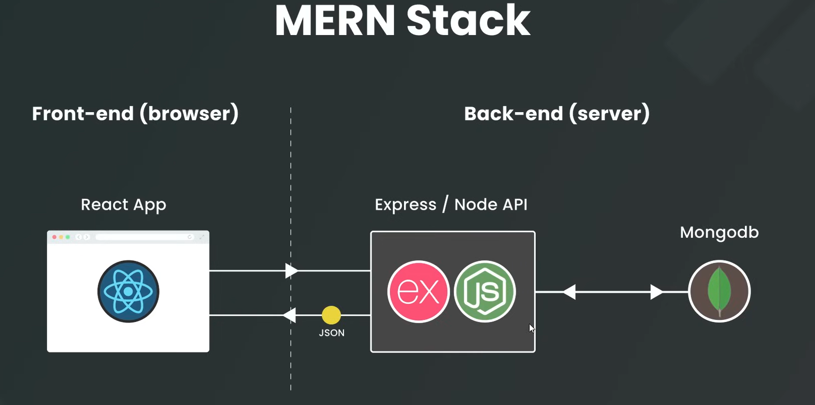

Slide 8
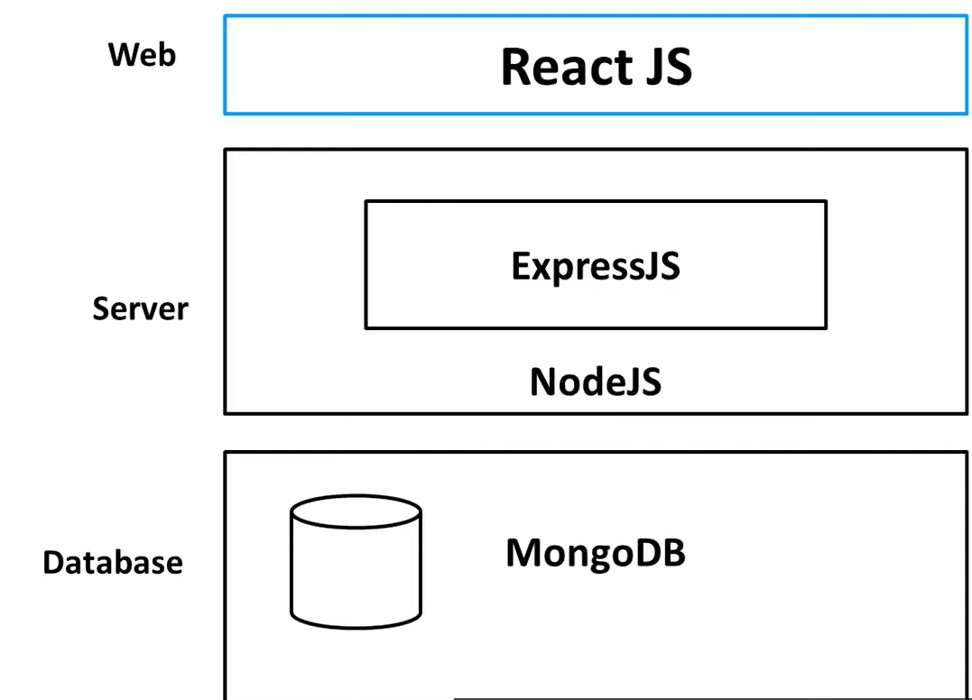
MongoDB and ReactJS cannot communicate with each other
Data should be shown at front end
Server comes in between in which Node JS and Express JS will run

Slide 9

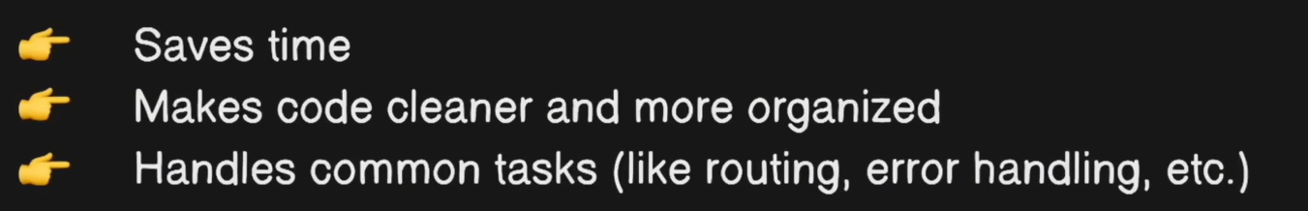

Slide 10
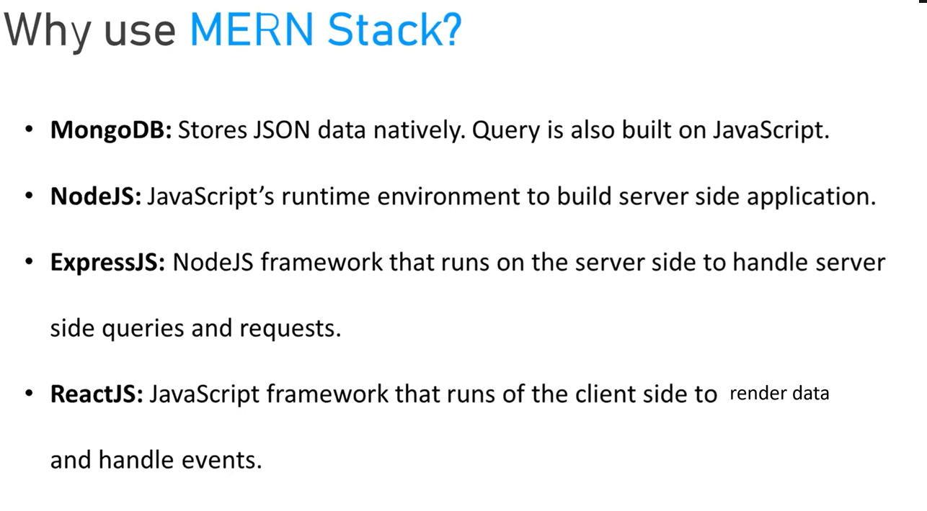
MongoDB is a non-relational database with stores data in JSON format. Its queries are based on Javascript
A single language Javascript is used to develop the entire stack. When the individual tiers communicate, there is no need of language switch, hence increased speed
When React JS requests for APIs from NodeJS or ExpressJS, then also there is no change in technology. No communication barrier.

Slide 11
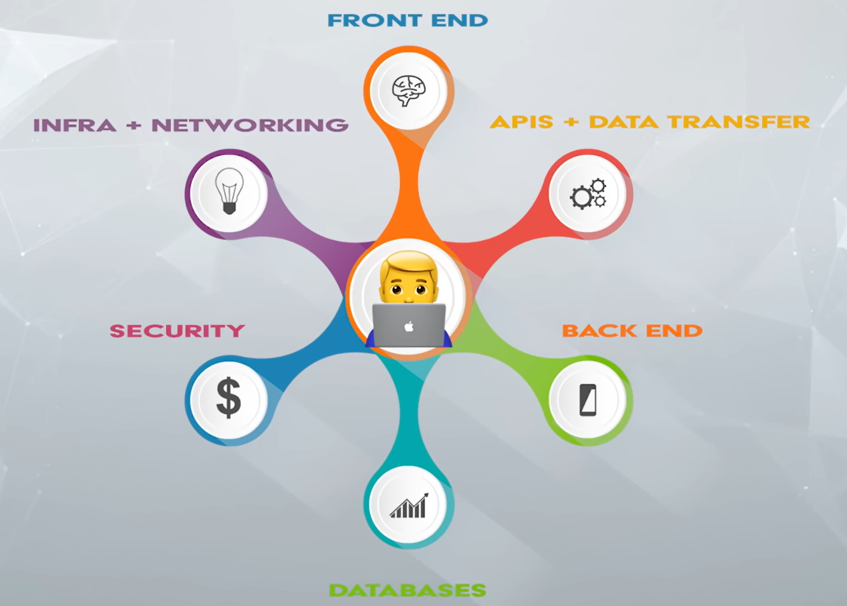
Web Development Stack

